Slide 1

CSE- 207
Algorithms
Lecture: 21
Minimum Spanning Tree
Fahad Ahmed
Lecturer, Dept. of CSE
E-mail: fahadahmed@uap-bd.edu

Slide 2


Minimum Spanning Tree

Slide 3
Minimum Spanning Tree
Tree: Connected Acyclic Graph
Spanning Tree: A tree that contains all vertices.
Formal definition: Given an connected weighted graph G, a Spanning tree is a subgraph that connects all vertices and acyclic.
Minimum Spanning tree:
Given a graph(V,E) and edge weights function w: E -> R, find the spanning tree of minimum weight.

Slide 4
Spanning Tree: Definition
A Spanning tree = a subset of edges from a connected graph that:
touches all vertices in the graph (spans the graph)
forms a tree (is connected and contains no cycles)
A
A
A
A
5
9
9
9
B
1
C
B
C
B
1
C
B
C
2
2
4
4
7
7
7
7
4
D
D
D
D
A weighted graph
Three spanning trees

Slide 5
Spanning Tree: properties
Some of the properties of the spanning tree are listed below:
A connected graph can have more than one spanning trees.
All spanning trees in a graph have the same number of nodes and edges.
If we remove one edge from the spanning tree, then it will become minimally connected and will make the graph disconnected.
On the other hand, adding one edge to the spanning tree will make it maximally acyclic thereby creating a loop.
A spanning tree does not have a loop or a cycle.

Slide 6
Spanning Tree: Definition
Minimum Spanning Tree: Spanning tree with the least total edge cost
A
A
A
A
5
9
9
9
B
1
C
B
C
B
1
C
B
C
2
2
4
4
7
7
7
7
4
D
D
D
D
A weighted graph
A
Three spanning trees
B
1
C
2
4
D
MST

Slide 7
Spanning Tree: Definition
What Is A Minimum Spanning Tree (MST)
A minimum spanning tree is the one that contains the least weight among all the other spanning trees of a connected weighted graph. There can be more than one minimum spanning tree for a graph.
A
A
5
9
1
C
B
1
C
B
2
2
4
4
7
D
D
MST
A weighted graph

Slide 8
Example
Given a weighted, undirected graph G=(V, E), compute the minimum cost spanning tree
MST may not be unique (unless all edge weights are distinct)
B
8
C
7
D
4
9
2
A
11
I
4
14
E
6
8
7
10
H
G
F
1
2
B
8
C
7
D
4
9
2
A
11
I
4
14
E
6
8
7
10
H
G
F
1
2

Slide 9
Application
Cluster analysis
Face verification
Avoid cycle in network
Network design(communication, electrical, computer, road)
Reducing data storage in sequencing amino acid in protein.

Slide 10
Computing MST–Unweighted Graphs
What if the graph is unweighted or all edge weights are equal?
Simply run BFS or DFS and the resulting tree is a MST
A
A
A
DFS(A)
BFS(A)
B
B
C
B
E
C
C
D
E
E
D
D

Slide 11
Computing MST – Weighted Graphs
Brute Force
Find all spanning tree and select the one with minimum total weight.
Complexity: Exponential

Slide 12
Computing MST – Weighted Graphs
We will present two greedy algorithms for computing MSTs in weighted graphs
Kruskal’s Algorithm
Prim’s Algorithm
A greedy algorithm
always makes choices that currently seem the best
Short-sighted – no consideration of long-term or global issues
Locally optimal does not always mean globally optimal. but works in some cases, e.g., MST, shortest-paths, Huffman coding, …

Slide 13
Greedy Algorithm
It grows one edge at a time
Assume, prior to each iteration, A is a subset of some minimum spanning tree.
At each step, we determine an edge (u, v) that we can add to A [A U (u,v)] and A still remain a subset of minimum spanning tree
This edge is called safe edge.
Algorithm
GENERIC-MST(G, w)
1 A =Ǿ ;
2 while A does not form a spanning tree
3 find an edge .u; / that is safe for A
4 A = A U {(u, v)}
5 return A

Slide 14
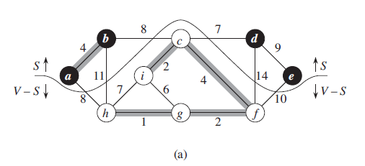
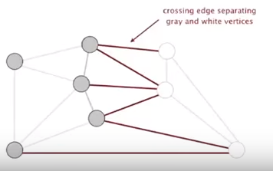
Cut Property
A Cut in a graph is a partition of its vertices into 2 non-empty set.
A crossing edge connects a vertex in one set with a vertex in the other set.
Cut property: Given any cut, the crossing edge of min weight is in MST.

Slide 15
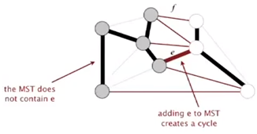
Proof
Suppose min-weight crossing edge e is not in MST
Some other crossing edge f should be in MST otherwise the graph will not be connected.
So, adding e to MST creates a cycle
Removing f and adding e is also a spanning tree
Since weight of e<weight of f
ST with e will have lower weight than ST with f.
This is a contradiction. So, f can’t be in MST

Slide 16
Greedy MST Algorithm
Start with all edge colored gray. [No edge is selected to be in MST]
Find a cut with no black crossing edge; color the min-weight crossing edge black.
Repeat until v-1 edges are colored black
B
8
C
7
D
4
9
2
A
11
I
4
14
E
6
8
7
10
H
G
F
1
2

Slide 17
Greedy MST Algorithm
Start with all edge colored gray. [No edge is selected to be in MST]
Find a cut with no black crossing edge; color the min-weight crossing edge black.
Repeat until v-1 edges are colored black
B
8
C
7
D
4
9
2
A
11
I
4
14
E
6
8
7
10
H
G
F
1
2

Slide 18
Greedy MST Algorithm
Start with all edge colored gray. [No edge is selected to be in MST]
Find a cut with no black crossing edge; color the min-weight crossing edge black.
Repeat until v-1 edges are colored black
B
8
C
7
D
4
9
2
A
11
I
4
14
E
6
8
7
10
H
G
F
1
2

Slide 19
Greedy MST Algorithm
Start with all edge colored gray. [No edge is selected to be in MST]
Find a cut with no black crossing edge; color the min-weight crossing edge black.
Repeat until v-1 edges are colored black
B
8
C
7
D
4
9
2
A
11
I
4
14
E
6
8
7
10
H
G
F
1
2

Slide 20
Greedy MST Algorithm
Start with all edge colored gray. [No edge is selected to be in MST]
Find a cut with no black crossing edge; color the min-weight crossing edge black.
Repeat until v-1 edges are colored black
B
8
C
7
D
4
9
2
A
11
I
4
14
E
6
8
7
10
H
G
F
1
2

Slide 21
Greedy MST Algorithm
Start with all edge colored gray. [No edge is selected to be in MST]
Find a cut with no black crossing edge; color the min-weight crossing edge black.
Repeat until v-1 edges are colored black
B
8
C
7
D
4
9
2
A
11
I
4
14
E
6
8
7
10
H
G
F
1
2

Slide 22
Greedy MST Algorithm
Start with all edge colored gray. [No edge is selected to be in MST]
Find a cut with no black crossing edge; color the min-weight crossing edge black.
Repeat until v-1 edges are colored black
B
8
C
7
D
4
9
2
A
11
I
4
14
E
6
8
7
10
H
G
F
1
2

Slide 23
Greedy MST Algorithm
Start with all edge colored gray. [No edge is selected to be in MST]
Find a cut with no black crossing edge; color the min-weight crossing edge black.
Repeat until v-1 edges are colored black
B
8
C
7
D
4
9
2
A
11
I
4
14
E
6
8
7
10
H
G
F
1
2

Slide 24
Greedy MST Algorithm
Start with all edge colored gray. [No edge is selected to be in MST]
Find a cut with no black crossing edge; color the min-weight crossing edge black.
Repeat until v-1 edges are colored black
B
8
C
7
D
4
9
2
A
11
I
4
14
E
6
8
7
10
H
G
F
1
2

Slide 25
Greedy MST Algorithm
Start with all edge colored gray. [No edge is selected to be in MST]
Find a cut with no black crossing edge; color the min-weight crossing edge black.
Repeat until v-1 edges are colored black
B
8
C
7
D
4
9
2
A
11
I
4
14
E
6
8
7
10
H
G
F
1
2

Slide 26
Greedy MST Algorithm
Start with all edge colored gray. [No edge is selected to be in MST]
Find a cut with no black crossing edge; color the min-weight crossing edge black.
Repeat until v-1 edges are colored black
B
8
C
7
D
4
9
2
A
11
I
4
14
E
6
8
7
10
H
G
F
1
2

Slide 27
Greedy MST Algorithm
Start with all edge colored gray. [No edge is selected to be in MST]
Find a cut with no black crossing edge; color the min-weight crossing edge black.
Repeat until v-1 edges are colored black
B
8
C
7
D
4
9
2
A
11
I
4
14
E
6
8
7
10
H
G
F
1
2

Slide 28
Greedy MST Algorithm
Start with all edge colored non-black. [No edge is selected to be in MST]
Find a cut with no black crossing edge; color the min-weight crossing edge black.
Repeat until v-1 edges are colored black
B
8
C
7
D
4
9
2
A
11
I
4
14
E
6
8
7
10
H
G
F
1
2

Slide 29
Greedy MST Algorithm
Start with all edge colored non-black. [No edge is selected to be in MST]
Find a cut with no black crossing edge; color the min-weight crossing edge black.
Repeat until v-1 edges are colored black
B
8
C
7
D
4
9
2
A
11
I
4
14
E
6
8
7
10
H
G
F
1
2

Slide 30
Greedy MST Algorithm
Start with all edge colored non-black. [No edge is selected to be in MST]
Find a cut with no black crossing edge; color the min-weight crossing edge black.
Repeat until v-1 edges are colored black
B
8
C
7
D
4
9
2
A
11
I
4
14
E
6
8
7
10
H
G
F
1
2

Slide 31
Greedy MST Algorithm
Start with all edge colored gray. [No edge is selected to be in MST]
Find a cut with no black crossing edge; color the min-weight crossing edge black.
Repeat until v-1 edges are colored black
B
8
C
7
D
4
9
2
A
11
I
4
14
E
6
8
7
10
H
G
F
1
2

Slide 32
Greedy MST Algorithm
Start with all edge colored gray. [No edge is selected to be in MST]
Find a cut with no black crossing edge; color the min-weight crossing edge black.
Repeat until v-1 edges are colored black
B
8
C
7
D
4
9
2
A
11
I
4
14
E
6
8
7
10
H
G
F
1
2

Slide 33
Greedy MST Algorithm
Start with all edge colored gray. [No edge is selected to be in MST]
Find a cut with no black crossing edge; color the min-weight crossing edge black.
Repeat until v-1 edges are colored black
B
8
C
7
D
4
9
2
A
11
I
4
14
E
6
8
7
10
H
G
F
1
2

Slide 34
Prim’s Algorithm

Slide 35
How does the prim's algorithm work?
How does the prim's algorithm work?
Prim's algorithm is a greedy algorithm that starts from one vertex and continue to add the edges with the smallest weight until the goal is reached.
The steps to implement the prim's algorithm are given as follows –
Remove all loops and parallel edges. Then Initialize the minimum spanning tree with a vertex chosen at random.
Find all the edges that connect the tree to new vertices, find the minimum and add it to the tree
Keep repeating step 2 until we get a minimum spanning tree

Slide 36
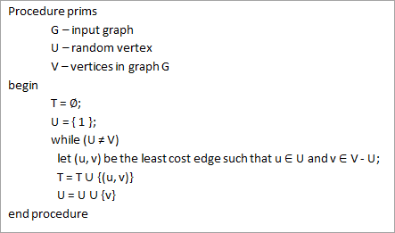
Pseudocode for Prim’s Algorithm

Slide 37
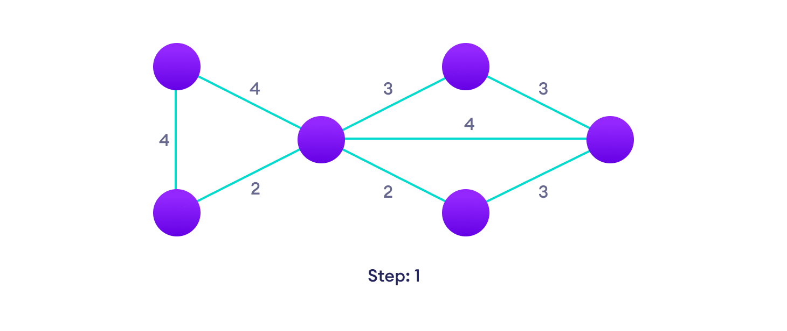
Example of Prim's algorithm
Start with a weighted graph

Slide 38

Example of Prim's algorithm
Choose the edge with the least weight, if there are more than 1, choose anyone

Slide 39

Example of Prim's algorithm
Choose the next shortest edge and add it

Slide 40
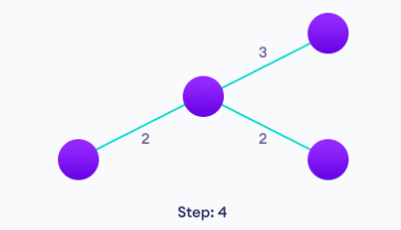
Example of Prim's algorithm
Choose the next shortest edge that doesn't create a cycle and add it

Slide 41
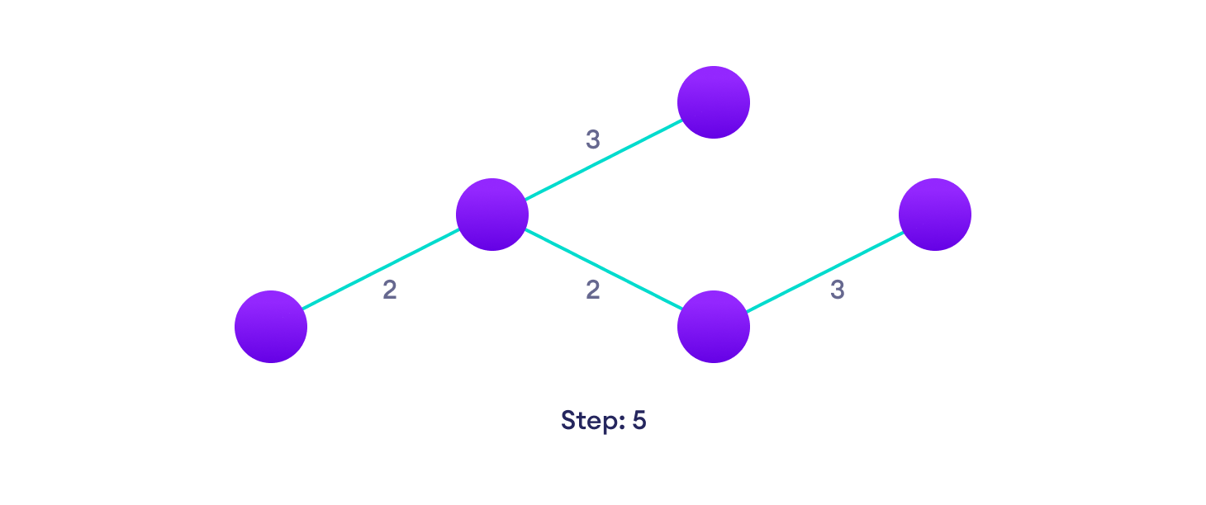
Example of Prim's algorithm
Choose the next shortest edge that doesn't create a cycle and add it

Slide 42
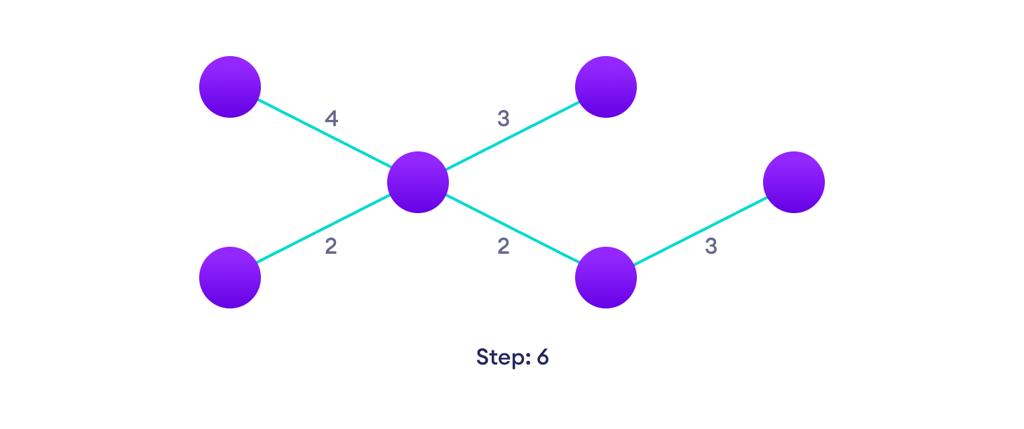
Example of Prim's algorithm
Repeat until you have a spanning tree

Slide 43
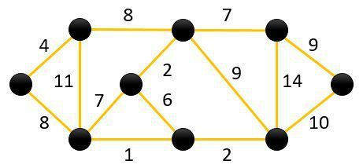
Example of Prim's algorithm (2)

Slide 44
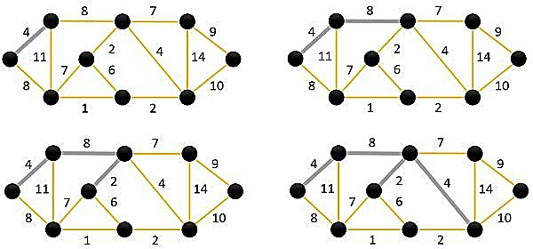
Example of Prim's algorithm (2)

Slide 45
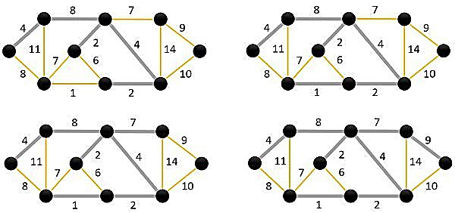
Example of Prim's algorithm (2)

Slide 46
prim's algorithm
Time Complexity
Data structure used for the minimum edge weight | Time Complexity
Adjacency matrix, linear searching | O(|V|²)
Adjacency list and binary heap | O(|E| log |V|)
Adjacency list and Fibonacci heap | O(|E|+ |V| log |V|)

Slide 47
Kruskal’s ALgorithm

Slide 48
Kruskal’s Algorithm
Remove all loops and Parallel Edges
Arrange all edges in their increasing order of weight
Add the edge which has the least weightage
Select the next shortest edge which does not create a cycle
Repeat step 2 until all vertices have been connected.

Slide 49
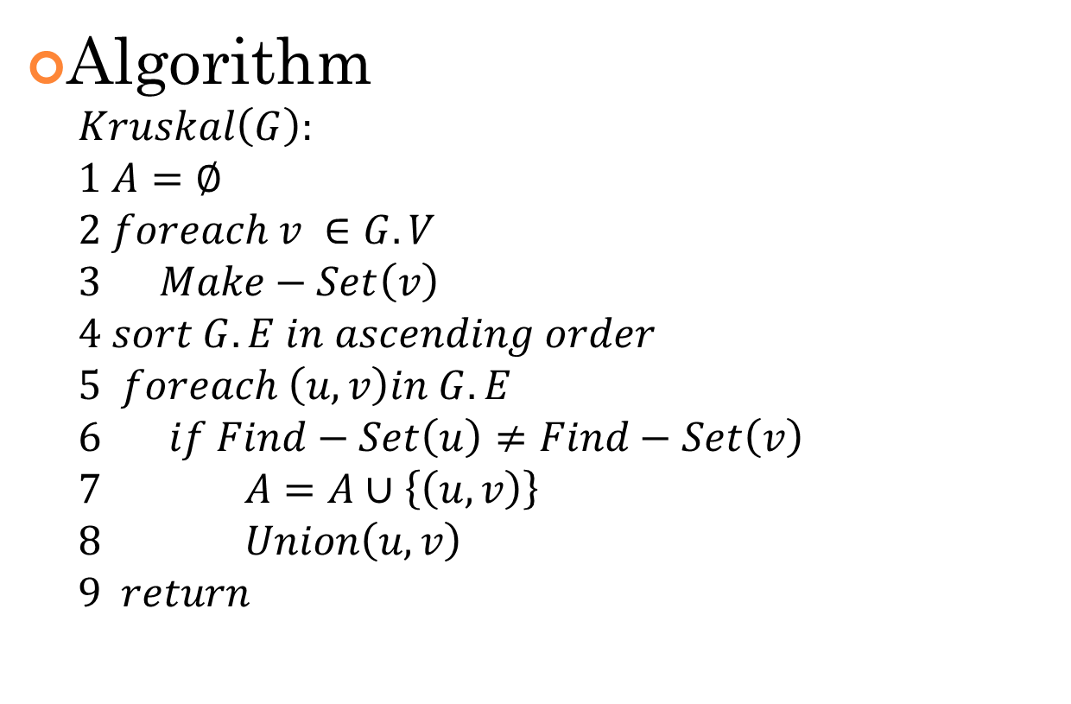
Kruskal’s Algorithm - pseudocode
Algorithm
$$Kruskal\left(G\right):$$
$$1 A=∅$$
$$2 foreach v ∈G.V$$
$$3 Make−Set\left(v\right)$$
$$4 sort G.E in ascending order$$
$$5 foreach \left(u, v\right)in G.E$$
$$6 if Find−Set\left(u\right)≠Find−Set\left(v\right)$$
$$7 A=A∪\left\{\left(u,v\right)\right\}$$
$$8 Union\left(u,v\right)$$
$$9 return$$

Slide 50
Kruskal’s Algorithm - Example
Given the graph below, create the MST using Kruskal’s algorithm.
B
8
C
7
D
4
9
2
A
11
I
4
14
E
6
8
7
10
H
G
F
1
2

Slide 51
Kruskal’s Algorithm - Example
Initial Set.
One vertex in each node
Edges are arranged in ascending order of cost.
Edge | Cost
G-H | 1
G-F | 2
C-I | 2
A-B | 4
C-F | 4
G-I | 6
C-D | 7
H-I | 7
A-H | 8
B-C | 8
D-E | 9
E-F | 10
B-H | 11
D-F | 14
B
C
D
A
I
E
H
G
F

Slide 52
Kruskal’s Algorithm - Example
Check G-H.
As G and H are not in same component, connect those.
Edge | Cost
G-H | 1
G-F | 2
C-I | 2
A-B | 4
C-F | 4
G-I | 6
C-D | 7
H-I | 7
A-H | 8
B-C | 8
D-E | 9
E-F | 10
B-H | 11
D-F | 14
B
C
D
A
I
E
H
G
F
1

Slide 53
Kruskal’s Algorithm - Example
Check G-F.
As G and F are not in same component, connect those.
Edge | Cost
G-H | 1
G-F | 2
C-I | 2
A-B | 4
C-F | 4
G-I | 6
C-D | 7
H-I | 7
A-H | 8
B-C | 8
D-E | 9
E-F | 10
B-H | 11
D-F | 14
B
C
D
A
I
E
H
G
F
1
2

Slide 54
Kruskal’s Algorithm - Example
Check C-I.
As C and I are not in same component, connect those.
Edge | Cost
G-H | 1
G-F | 2
C-I | 2
A-B | 4
C-F | 4
G-I | 6
C-D | 7
H-I | 7
A-H | 8
B-C | 8
D-E | 9
E-F | 10
B-H | 11
D-F | 14
B
C
D
2
A
I
E
H
G
F
1
2

Slide 55
Kruskal’s Algorithm - Example
Check A-B.
As A and B are not in same component, connect those.
Edge | Cost
G-H | 1
G-F | 2
C-I | 2
A-B | 4
C-F | 4
G-I | 6
C-D | 7
H-I | 7
A-H | 8
B-C | 8
D-E | 9
E-F | 10
B-H | 11
D-F | 14
B
C
D
4
2
A
I
E
H
G
F
1
2

Slide 56
Kruskal’s Algorithm - Example
Check C-F.
As C and F are not in same component, connect those.
Edge | Cost
G-H | 1
G-F | 2
C-I | 2
A-B | 4
C-F | 4
G-I | 6
C-D | 7
H-I | 7
A-H | 8
B-C | 8
D-E | 9
E-F | 10
B-H | 11
D-F | 14
B
C
D
4
2
A
I
4
E
H
G
F
1
2

Slide 57
Kruskal’s Algorithm - Example
Check G-I.
As G and I are in same component, do not connect those.
Edge | Cost
G-H | 1
G-F | 2
C-I | 2
A-B | 4
C-F | 4
G-I | 6
C-D | 7
H-I | 7
A-H | 8
B-C | 8
D-E | 9
E-F | 10
B-H | 11
D-F | 14
B
C
D
4
2
A
I
4
E
H
G
F
1
2

Slide 58
Kruskal’s Algorithm - Example
Check C-D.
As C and D are not in same component, connect those.
Edge | Cost
G-H | 1
G-F | 2
C-I | 2
A-B | 4
C-F | 4
G-I | 6
C-D | 7
H-I | 7
A-H | 8
B-C | 8
D-E | 9
E-F | 10
B-H | 11
D-F | 14
B
C
7
D
4
2
A
I
4
E
H
G
F
1
2

Slide 59
Kruskal’s Algorithm - Example
Check H-I.
As H and I are in same component, do not connect those.
Edge | Cost
G-H | 1
G-F | 2
C-I | 2
A-B | 4
C-F | 4
G-I | 6
C-D | 7
H-I | 7
A-H | 8
B-C | 8
D-E | 9
E-F | 10
B-H | 11
D-F | 14
B
C
7
D
4
2
A
I
4
E
H
G
F
1
2

Slide 60
Kruskal’s Algorithm - Example
Check A-H.
As A and H are not in same component, connect those.
Edge | Cost
G-H | 1
G-F | 2
C-I | 2
A-B | 4
C-F | 4
G-I | 6
C-D | 7
H-I | 7
A-H | 8
B-C | 8
D-E | 9
E-F | 10
B-H | 11
D-F | 14
B
C
7
D
4
2
A
I
4
E
8
H
G
F
1
2

Slide 61
Kruskal’s Algorithm - Example
Check B-C.
As B and C are in same component, do not connect those.
Edge | Cost
G-H | 1
G-F | 2
C-I | 2
A-B | 4
C-F | 4
G-I | 6
C-D | 7
H-I | 7
A-H | 8
B-C | 8
D-E | 9
E-F | 10
B-H | 11
D-F | 14
B
C
7
D
4
2
A
I
4
E
8
H
G
F
1
2

Slide 62
Kruskal’s Algorithm - Example
Check D-E.
As D and E are in not same component, connect those.
Edge | Cost
G-H | 1
G-F | 2
C-I | 2
A-B | 4
C-F | 4
G-I | 6
C-D | 7
H-I | 7
A-H | 8
B-C | 8
D-E | 9
E-F | 10
B-H | 11
D-F | 14
B
C
7
D
4
9
2
A
I
4
E
8
H
G
F
1
2

Slide 63
Kruskal’s Algorithm - Example
Check the last 3 edges.
E & F, B & H, D & F are in same component, no need to connect those.
Edge | Cost
G-H | 1
G-F | 2
C-I | 2
A-B | 4
C-F | 4
G-I | 6
C-D | 7
H-I | 7
A-H | 8
B-C | 8
D-E | 9
E-F | 10
B-H | 11
D-F | 14
B
C
7
D
4
9
2
A
I
4
E
8
H
G
F
1
2

Slide 64
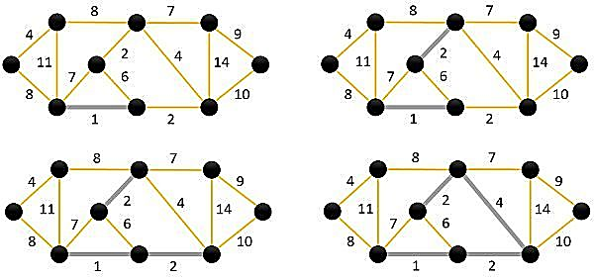
Kruskal’s Algorithm – Example (all steps in a figure)

Slide 65
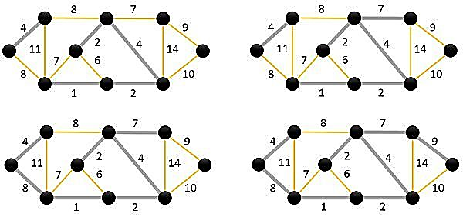
Kruskal’s Algorithm – Example (all steps in a figure)

Slide 66
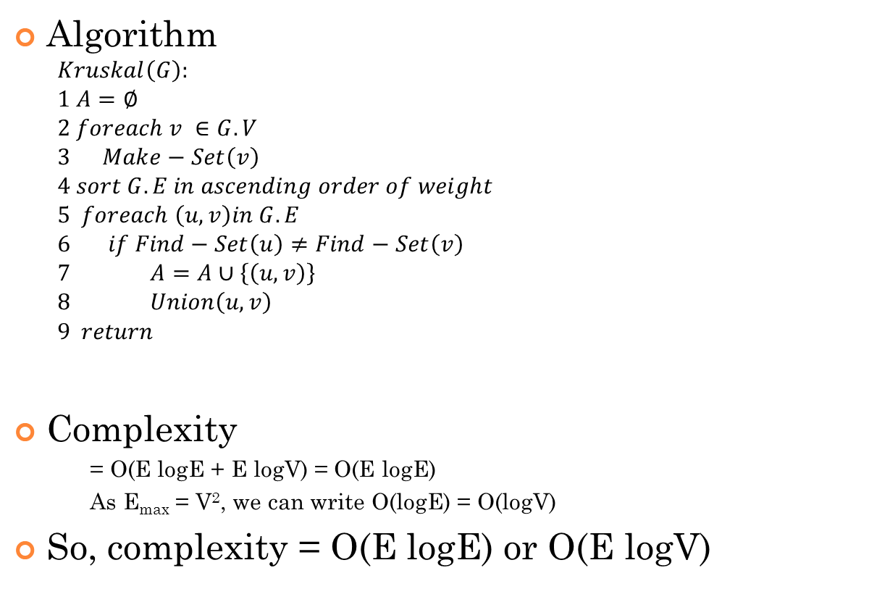
Kruskal’s Algorithm - Complexity
Algorithm
$$Kruskal\left(G\right):$$
$$1 A=∅$$
$$2 foreach v ∈G.V$$
$$3 Make−Set\left(v\right)$$
$$4 sort G.E in ascending order of weight$$
$$5 foreach \left(u, v\right)in G.E$$
$$6 if Find−Set\left(u\right)≠Find−Set\left(v\right)$$
$$7 A=A∪\left\{\left(u,v\right)\right\}$$
$$8 Union\left(u,v\right)$$
$$9 return$$
Complexity
= O(E logE + E logV) = O(E logE)
As E_{max} = V², we can write O(logE) = O(logV)
So, complexity = O(E logE) or O(E logV)
V
E logE
E
E logV
E logV
V logV

Slide 67


Slide 68
Prim’s vs Kruskal’s for MST
BASIS FOR COMPARISON | PRIMS ALGORITHM | KRUSKAL ALGORITHM
Basic | The algorithm obtains the minimum spanning tree by choosing the adjacent vertices from a set of selected vertices. | To obtain the minimum spanning tree this algorithm select the edges from a set of edges.
Selection of the route is based on | Vertices | Edges
Connected components | All the graph components must be connected. | Disconnected graph may present.
Speed | Better for the dense graph. | Good for the sparse graph.
Time complexity | O(V²) | O(log V)
Initiates with | A node. | An edge.
Adjacent vertices | Must be opted for the tree. | Selected vertices are not necessarily adjacent.

Slide 69
Try at home
Is MST always unique for a graph?
Hints: 2 components can be connected via multiple edges.
Is minimum weight edge always included in MST?
Hints: think about non-unique weight edges.
Negate the weights
Increase all weights by a fixed number.

Slide 70
Reference
Chapter 23 (Cormen) -> 23.1, 23.2
https://www.programiz.com/dsa/kruskal-algorithm
https://www.programiz.com/dsa/prim-algorithm

